Slide 1
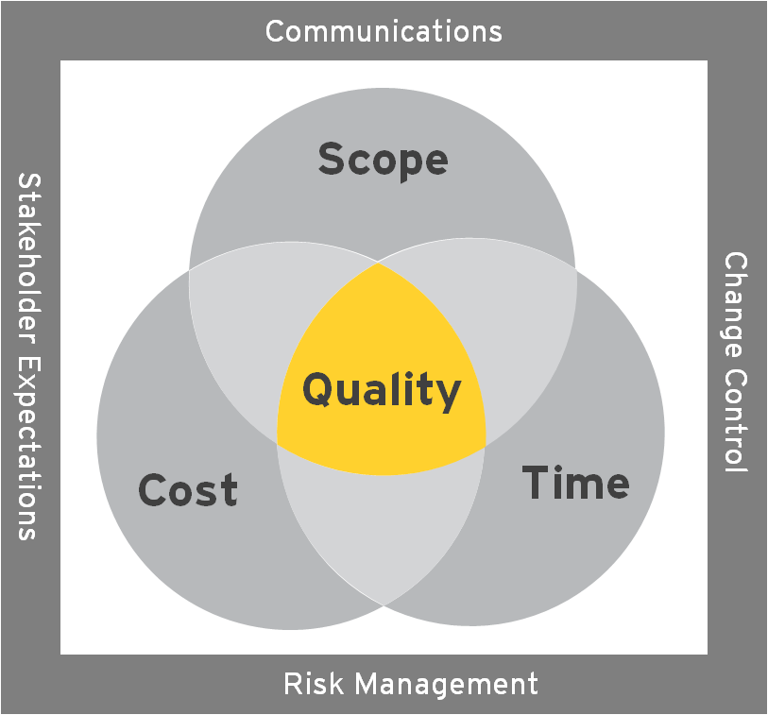
7. RAID trends and observations
Top Critical Risks and Issues
Item | Background | Description
 | Note: RAIDs are being reviewed and managed with program leadership on a daily basis in the Daily Status Review meetings as part of the Get to Green 30 Day Plan. Therefore, no specific items have been called out for inclusion in this pack.

Slide 2
2. Overall assessment of Program health
PMO Narrative
Budget
Schedule – Overall status RED
Resource.
RAIDs. RAG status reflects the workstream’s progress with regards to the completion of cleaning up of their RAIDs (taking into account updated details and overdue items). RAID activity continues to progress with the advancement of the M&C Get to Green 30 day plan. Overdue items are steadily declining. Assumptions to be validated remain in need of review, as do both pending decisions and decisions to be revalidated. Weekly M&C Program RAID meetings are on hold for four weeks, as attention will be dedicated to the daily reviews instead.
Commercial/Vendor.
General .
Weekly Ratings
 | Program Assessment (Per PM Tool) |  |  |  | PMO Assessment
Program | Overall | Scope | Time | Cost | RAID | Resource | Financial | Schedule | Vendor
SharePoint |  |  |  |  | Red
App & Data |  |  |  |  | Green
Change Management |  |  |  |  | Green
Unified Communications |  |  |  |  | Amber
Tech Foundation |  |  |  |  | Amber
IT Transition Management |  |  |  |  | Amber
Business Deployment
Release Management
Overall |  |  |  |  | Red
 |  | RAG Trend
Program | This week | Last week | Week -2 | Week -3 | Week -4 | Week -5 | Week -6
SharePoint
App & Data
Infrastructure
Change Management
Tech Foundation
Unified Communications
IT Transition Management
Business Deployment
Release Management
Notes:
Cost
GREEN - Estimate at Completion (EAC) = + 0 - 5% of approved spend (cost baseline + approved change requests)
AMBER - Estimate at Completion (EAC) = + 6 - 10% of approved spend (cost baseline + approved changes) and/or pending spend
RED – Estimate at Completion (EAC) exceeds + 10% or $100,000 of approved spend (cost baseline + approved changes) and/or pending spend or no project budget defined
Schedule
GREEN - The project schedule supports the end date of the project (with some elapsed time contingency).
AMBER - The project schedule supports the end date, but issues, risks and/or changes exist that may put the date in jeopardy.
RED – The project schedule does not exist and/or the project schedule does not support the end of the project.
Scope
GREEN - Scope defined and approved (scope baseline) with no pending change requests.
AMBER - Scope defined and approved (scope baseline) with pending change requests – known and not raised and raised but not agreed.
RED – Scope undefined or unapproved (no scope baseline) and/or multiple pending change requests.
Risk
GREEN – Low amount of risks with negligible impact
AMBER – Medium amount of risks. High or medium impact but with mitigation actions in place. Time left to put in place mitigation plans.
RED – High number of risks. High score risks which impact in the near term. No mitigation in place for High risks.
Issue
GREEN – No or low impact issues. Medium impact issues with resolution plans agreed and in place.
AMBER – Large amount of issues and/or Medium impact issues with no resolution plans.
RED – High impact issues present. No resolution plans in place for Medium of High level issues
Commercial
GREEN - TBD
AMBER - TBD
RED – TBD
Resource
GREEN – No resource issue or constraints
AMBER – Resource issues exist but plans are in place to resolve.
RED – Resource issues exist with no plans in place to resolve.

